Slide 1
A Beginner’s Guide to
Media Outreach
Jessica Schorr Saxe, MD
Health Care Justice – NC

Slide 2
Create the Opportunity and Enjoy It!
Understand the media
Just regular folks, but extra busy
They need you, and you need them
Timing is everything.
Keep your eye on the prize and have fun!

Slide 3
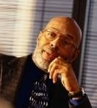
Do Your Homework
Know the audience
Know the medium: Staff, policies, and positions

Slide 4
Enjoy Building Your Relationships
Be friendly. Attract with honey.
Be helpful and available.
Use your connections.

Slide 5
Tips on Relationships
Supply them with
information of interest
Always be accurate
Be resourceful about others
to quote, finding information
Compliment your adversaries

Slide 6
When to Complain
Be judicious and tactful
Significant errors

Slide 7
Writing Op-Eds
Ask for guidelines
and where to submit
Send query of interest
Research the policies –
and stay within them

Slide 8
Imagine Your Patients Reading It
Be concise
Active short paragraphs
Know your paper’s word-count limits
Don’t be dry
Be a little controversial
Use a little humor and irony
Know your audience
Assume they know nothing about your topic
Avoid jargon
Key message is
“What’s in it for them?

Slide 9
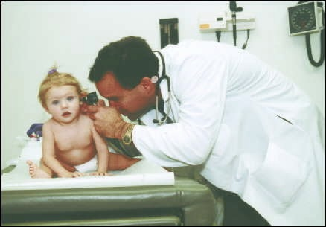
Tips
Remember your expertise
Tell stories
Protect confidentiality

Slide 10
More Tips
Be meticulous
Everyone can use an editor
The less work they have to do, the better

Slide 11
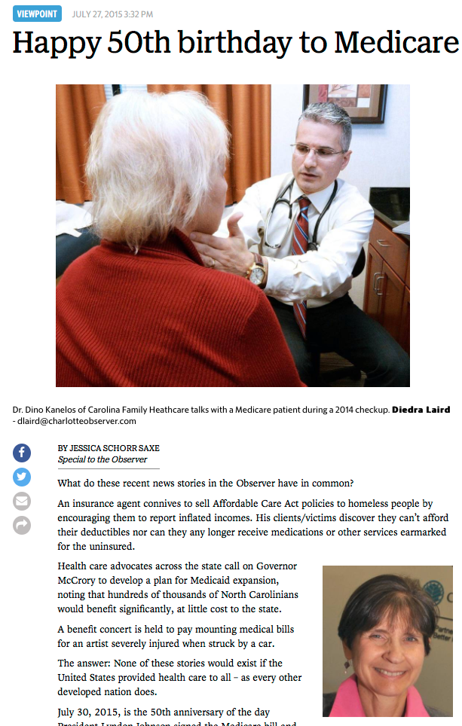
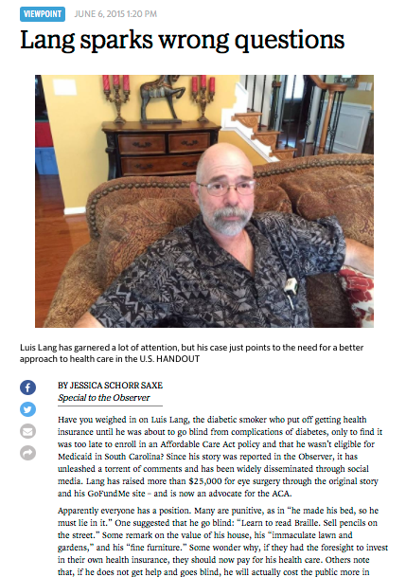
Timing, Timing, Timing!
Watch for “news hooks”
Local issue or local perspective on national issues
If timing is wrong but article is good, consider reworking and submitting later

Slide 12
Submitting Op-Eds
Stay within their word count!
Headline with author name and word count
15-word tagline about the author
Subject line should reflect content (not just “op-ed column”)

Slide 13
“Groups that focus only on op-eds
do themselves a disservice.
Letters are very well read,
reflect the community.”
Marjorie Prichard
Op-ed page editor for the Boston Globe since 1987
Past president of the National Association of Opinion Page Editors.

Slide 14
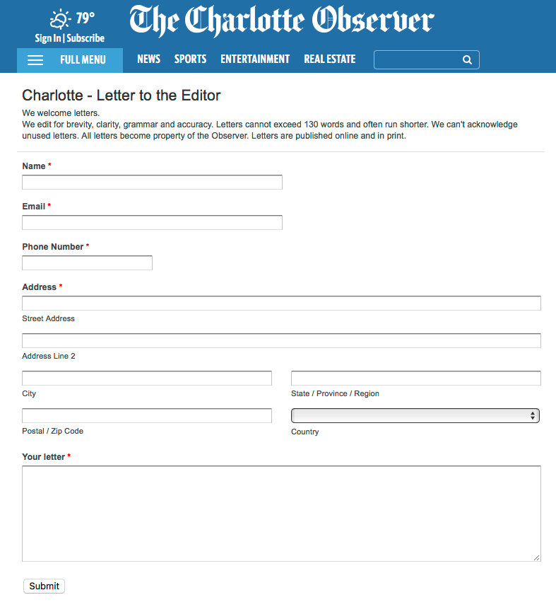
Letters to the Editor
Know their policies
Read their other LTEs
Be succinct and catchy

Slide 15
Keep the Dialogue Alive
Letters to the editor
Timely response to their articles
Comment on other letters
On-line forums
Keep to the high ground
Speak as a physician, establish credibility
2-3 cycles

Slide 16
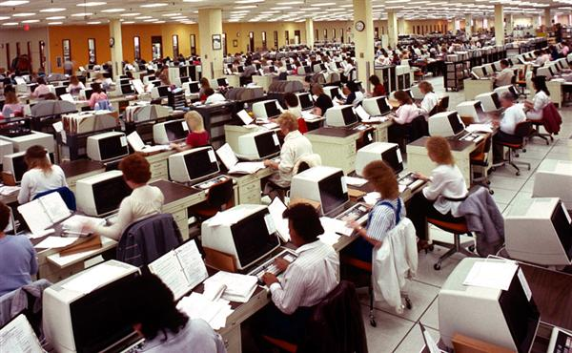
Mobilize Your Network
Recruit others to write letters after news event, article—immediately
Know policy on frequency of LTEs
Rotate writers

Slide 17
Maximize Your Reach
Use social media
Forward to your network

Slide 18
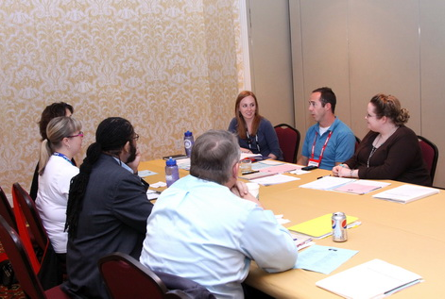
Editorial Board Meetings
What are they?
Why request one?
Prepare
Be a sleuth
Request the meeting
Act
At the meeting
Follow-up
Timing is key!
Prepare, prepare, prepare
Watch for results
Basics

Slide 19
Your Events
Keep a media list to inform
Use variety of media
National speakers:
Ask them to do pre-event interviews
Offer visits to both the news and editorial sides

Slide 20
Use Your Resources
Making the News, Jason Salzman, 2003
Mark Almberg, PNHP National, Communications Director
Dixon Galvez-Searle, PNHP National, Communications Specialist

